Slide 1
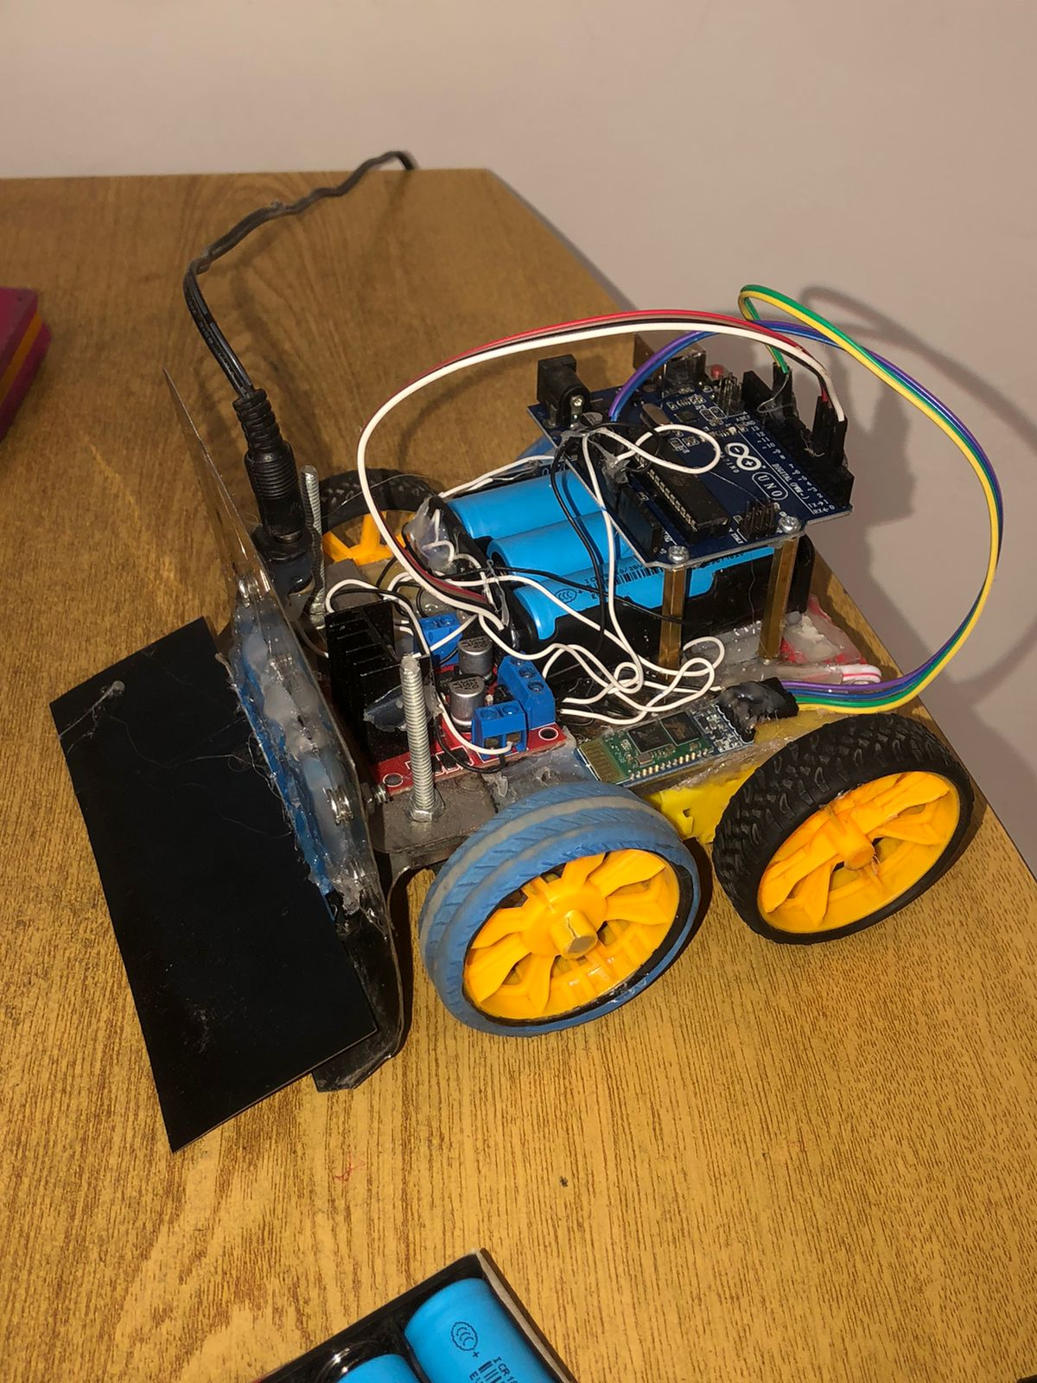
OOP SEMESTER PROJECT
Sumo Robot Using C++ and OOP
Presenter:
Talal Arshad FA24-EEE-048

Slide 2
Problem Statement & Objective
In the original Arduino code, all logic was written in the setup and loop functions. This created messy, repeated, and hard-to-update code. Our objective was to convert the entire project into an Object-Oriented design, using principles like:
Encapsulation
Abstraction
Composition
Modularity
This makes the robot easier to maintain and expand in future projects.

Slide 3

Motor Class
We created a Motor class to represent a single DC motor.
Purpose of this class:
Store the pin numbers
Provide simple functions to move a motor forward, backward, or stop
Why this class is important:
Instead of writing digital Write again and again, we now only call functions like forward(), backward(), stop().
Encapsulation used:
Pin numbers are private
Movement methods are public This protects the internal implementation.
This class reduces code repetition and increases clarity

Slide 4


MotorDriver Class
This class contains two Motor objects, one for the left motor and one for the right. This is the concept of composition, meaning a MotorDriver is made up of motors.
Purpose of MotorDriver class:
Control both motors together
Provide high-level functions:
moveForward()
moveBackward()
turnLeft()
turnRight()
stop()
Why this helps:
Instead of manually controlling two motors separately, we now call one function like moveForward(), and it automatically controls both motors.
Abstraction used:
The user doesn’t need to know which motor spins how.
They just call a single function, and the driver handles the details.
This makes the movement logic clean, organized, and reusable

Slide 5


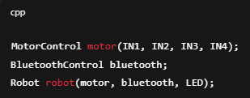
Robot Class
This class represents the entire robot as a single object.
Inside this class:
We have the MotorDriver object
We have one function for each robot behavior
The robot understands commands like 'F', 'B', 'L', 'R'
Purpose of Robot class:
Connect high-level commands with actual motor movement
Provide functions such as:
goForward()
goBackward()
turnLeft()
turnRight()
stop()
Benefits:
Makes our code modular
Separates hardware-level logic from robot behavior
If in the future we add sensors, we can add them here easily
The Robot class is the brain that links Bluetooth commands and motor actions.

Slide 6


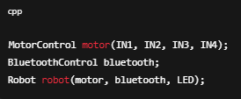


Bluetooth Controller Class
Purpose:
Handle communication between the smartphone and the robot
Read characters like ‘F’, ‘B’, ‘L’, ‘R’
Send this command to the Robot class
How it works:
We pass a reference to the robot
When data arrives via Bluetooth, this class checks what the command is
Then it tells the robot what to do
This separates communication logic from movement logic, which improves clarity.

Slide 7

Conclusion
Our OOP version of the Bluetooth robot successfully demonstrates:
Encapsulation: Each class hides its internal details
Abstraction: High-level functions simplify robot control
Inheritance (conceptual—not used): Could be added for upgraded robot versions
Composition: MotorDriver is composed of Motor objects
Modularity: Each part of the robot has its own class
Why our OOP design is better than the original code:
Cleaner
Easier to debug
Easy to expand
Reusable functions
Separated responsibilities
Thank you for listening. We are open to questions

